Slide 1
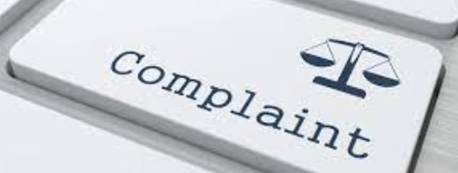
COMPLAINT REDRESSAL SYSTEM
BY GROUP NO - 2

Slide 2
GROUP MEMBERS
FRONT END BACK END
Hitasha Kakkad Gunti Gautam
Dinesh Dath Deepak Gupta
Harsha Vardhan BD. Gouthami
D.Ruchidar Gaurav Jat
Dodla Saketh Krishna Sai

Slide 3
CONTENTS
INTRODUCTION
PROJECT SCOPE
EXISTING SYSTEM
PROPOSED SYSTEM
FLOW CHART
REQUIREMENTS
ASSUMPTIONS
ADVANTAGES
DATABASE SCHEMA
DATA DIRECTORY
OUTPUT
CONCLUSON

Slide 4
INTRODUCTION
ABC Telecom Ltd. is one of India’s major telecommunication service providers offering landline, mobile phone and Fiber optic broadband services across the country. Their customer services group is interested in providing a set of customer redressal services through the , development of a new application using the state-of-art technologies such as Spring-boot for the development of java-based services, and UI using Angular and integrate them suitably, so that all the necessary services are taken care of through this application.

Slide 5
ABC TELECOM LTD
LANDLINE
MOBILE PHONE
BROADBAND SERVICES
COMPLAINT REDRESSAL SYSTEM

Slide 6
PROJECT SCOPE
The system is convenient and flexible to be used, it saves the time, efforts, money and resources
This complaint redressal system can efficiently manage the company customer details and their complaints
provides instant access and improves productivity.
The system is used to keep the records of the complaints , customers details , managers and engineers
This system is used to provide online services to its customers.
Option to complaint for any existing/new client.
This system provides information about the complaints customer details through online.
All communication happens online which is faster and more reliable

Slide 7
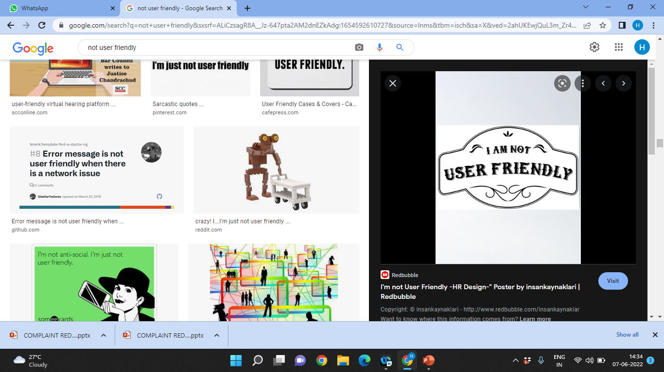
EXISTING SYSTEM
In the existing system, people must go to the office for any kind of help.
Self service
The users can raise the complaint but cannot get the details of the problems and some other services.
This system doesn’t have much popularity and is not user friendly.

Slide 8

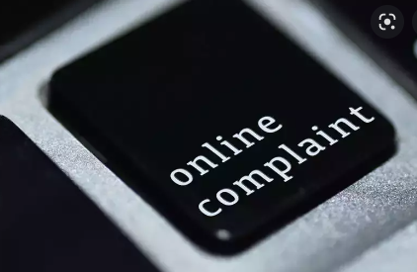
Proposed system
In the proposed system , the user can raise their complaint through Online without going anywhere.
Customer can login into the portal and can view and track the complaints related to the services availed by them.
Customer can give the feedback on the resolution of the complaint .

Slide 9
FLOW CHART
START
ADMIN
MANAGER
ENGINEER
CUSTOMER
Maintains the life cycle of Customer’s,
Manager’s and Engineer’s
View all the Tickets and Status
Assign Complaints to different Engineers.
View Customer’s Feedback.
View and work on complaints and assign the new status. View the customer feedback
Can raise and track the complaints and can also provide feedback .

Slide 10
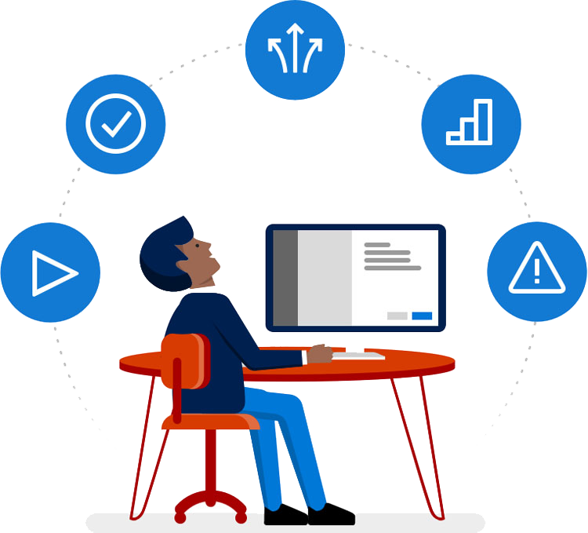
REQUIREMENTS
Front-End : Angular
Server-side : Spring Boot
Back-end : MYSQL, Hibernate
Server : Tomcat

Slide 11
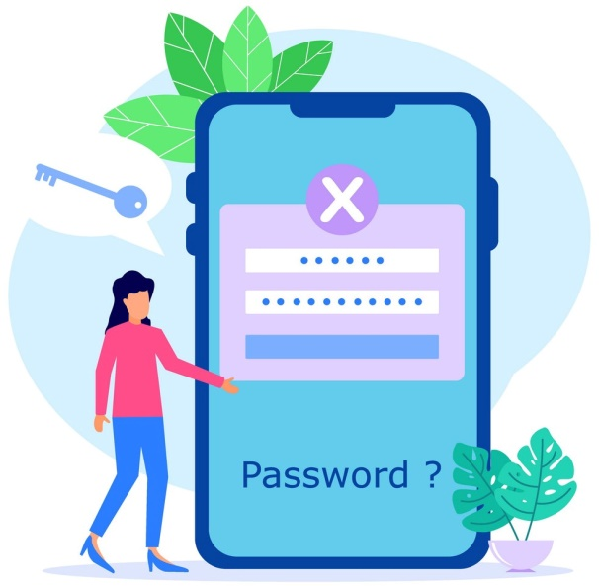
ASSUMPTIONS
Each User(Admin, Customer, Manager, Engineer) must have a valid Email id and Password.
Customer must be logged in to the system to raise their complaints.
Only Admin can delete and update the records.
Managers can assign and view the complaints of the customers.

Slide 12
ADVANTAGES
Digital Complaint Records
Less Time Consuming
Complaint resolved in short period of time
Reduce the cost of poor quality

Slide 13
DATABASE DESIGN SCHEMA
DOMAIN OBJECT
ADMIN
CUSTOMER
MANAGER
ENGINEER
LOGIN
VIEW MANAGER
VIEW CUSTOMER
VIEW ENGINEER
VIEW COMPLAINTS
VIEW FEEDBACK
REGISTER
LOGIN
COMPLAINT
FEEDBACK
REGISTER
LOGIN
FEEDBACK
REGISTER
LOGIN
FEEDBACK

Slide 14
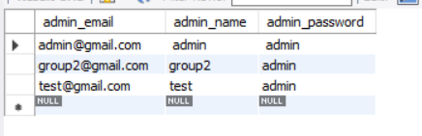
DATA DIRECTORY
ADMIN

Slide 15
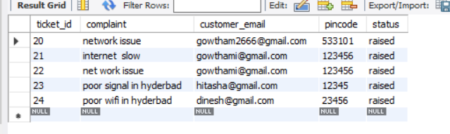
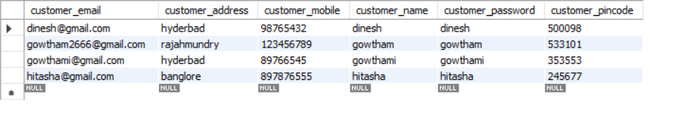
COMPLAINT
CUSTOMER

Slide 16
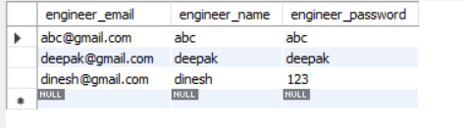
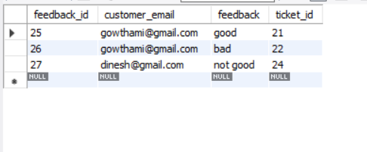
ENGINEER
FEEDBACK

Slide 17
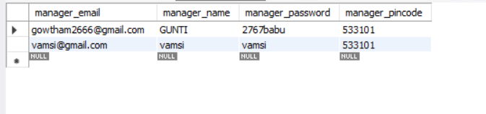
MANAGER

Slide 18
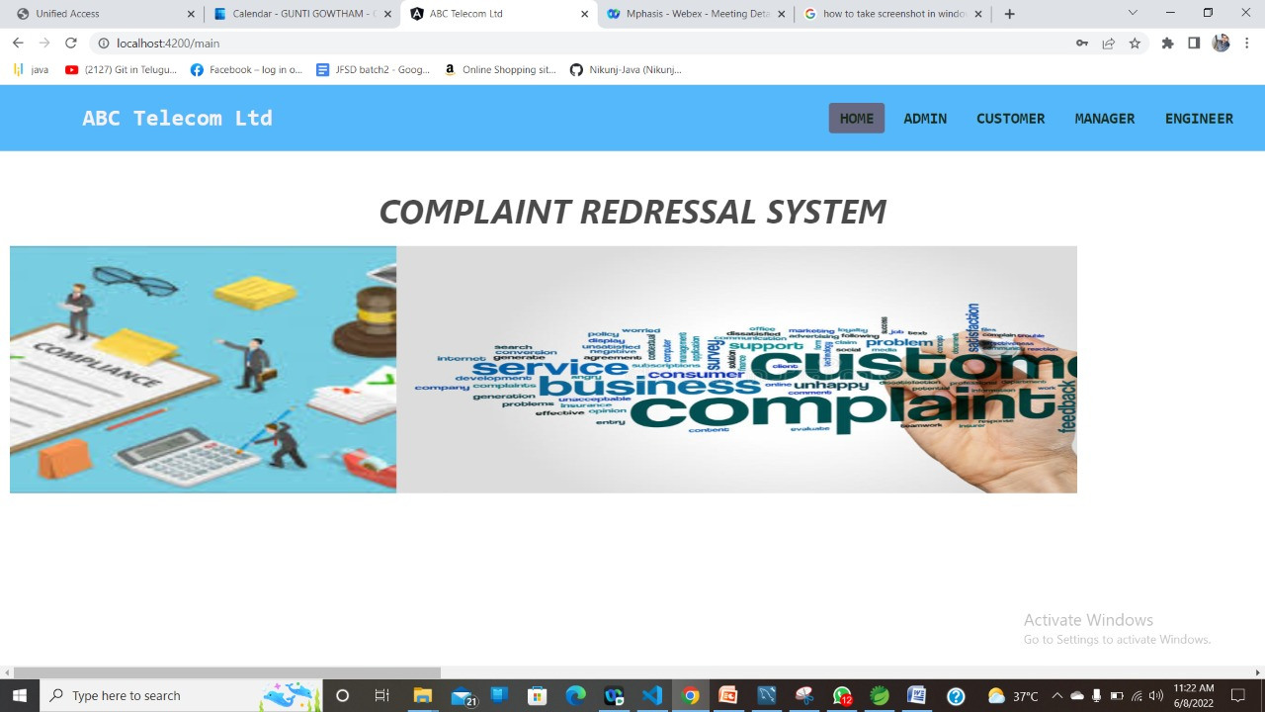
HOME PAGE

Slide 19
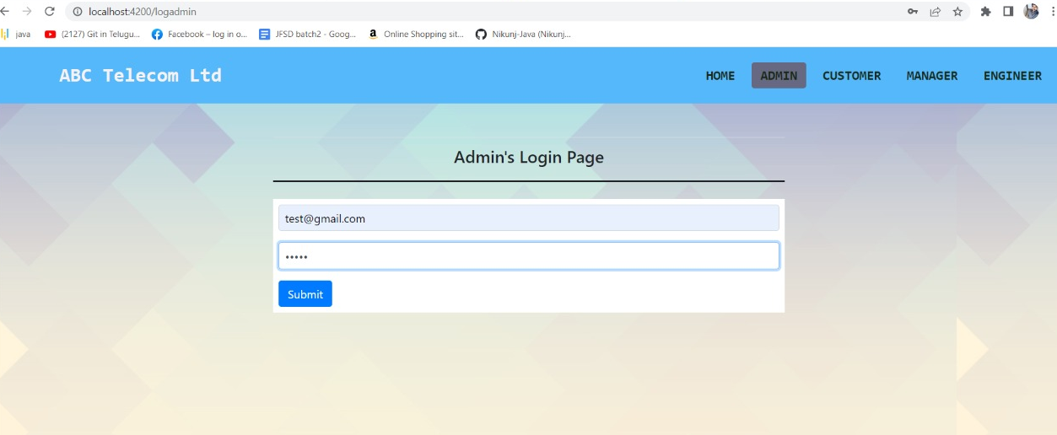
ADMIN PAGE

Slide 20
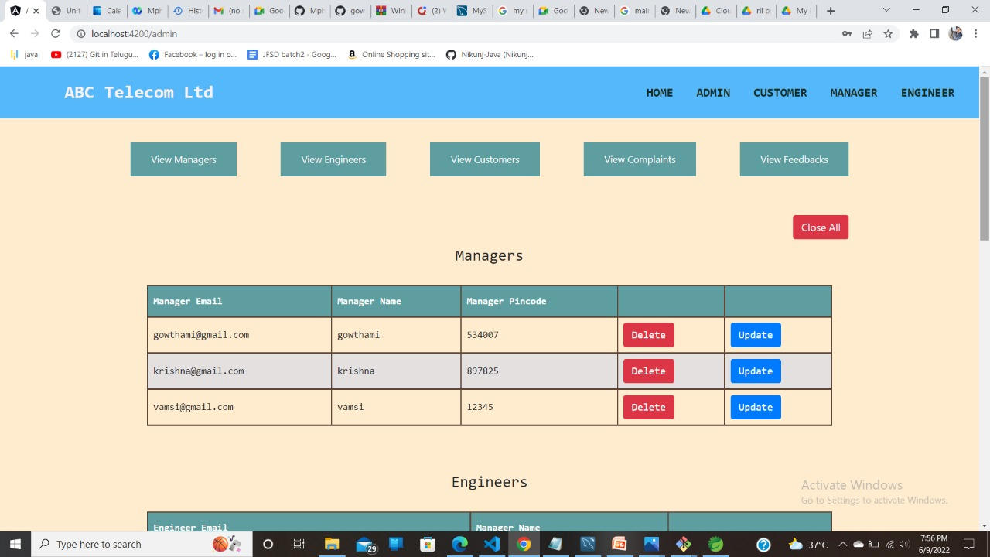
VIEW MANAGERS

Slide 21
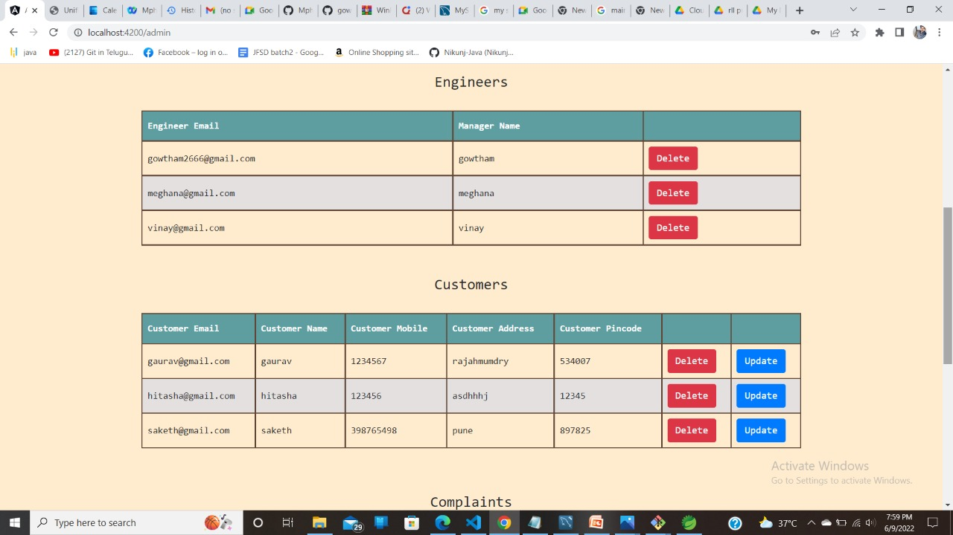
VIEW ENGINEERS AND CUSTOMERS

Slide 22
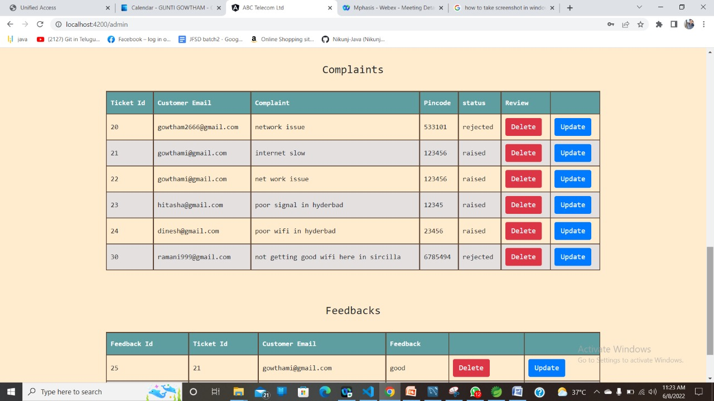
VIEW COMPLAINTS

Slide 23
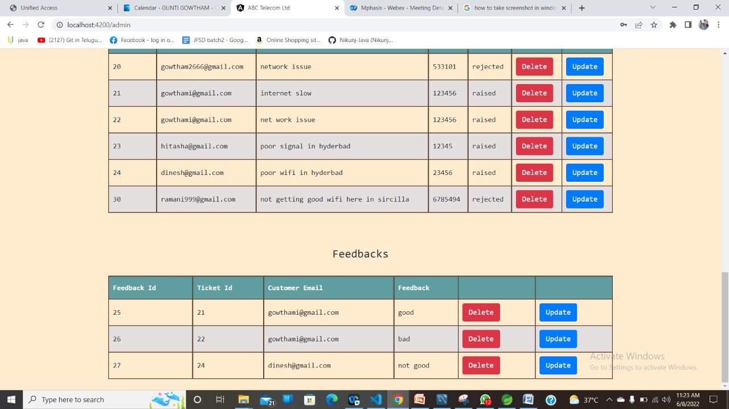
VIEW FEEDBACKS

Slide 24
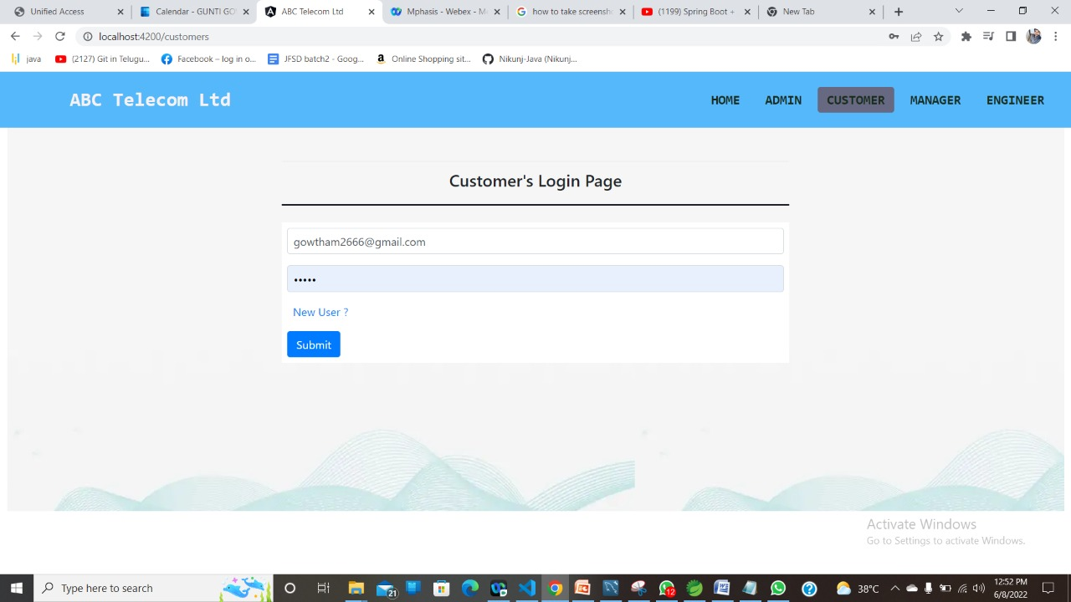
CUSTOMERS PAGE

Slide 25
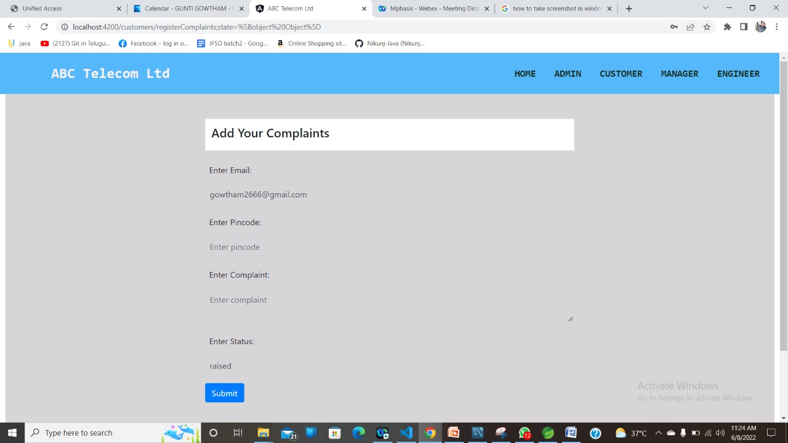
COMPLAINTS PAGE

Slide 26
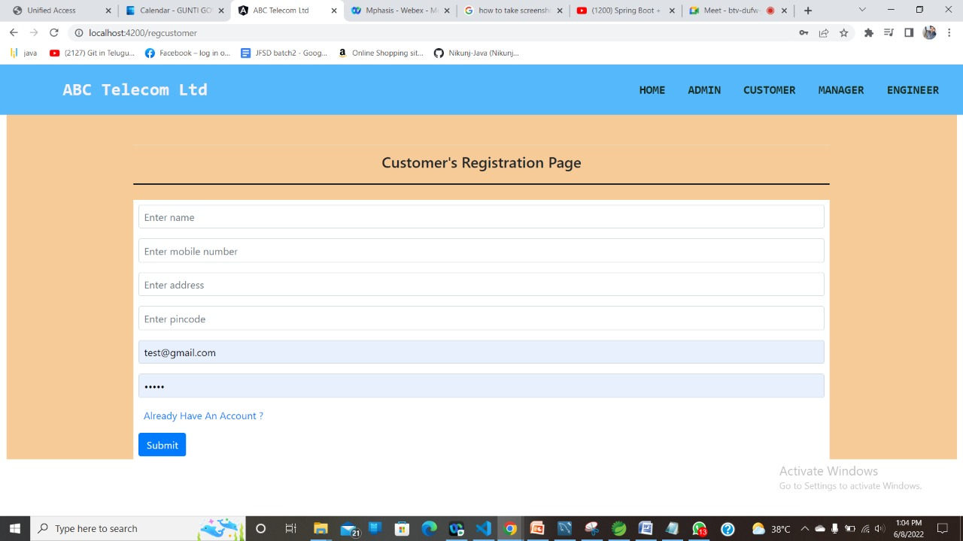
NEW USERS PAGE

Slide 27
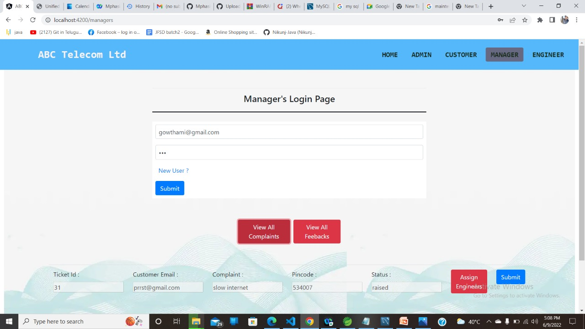
MANAGERS LOGIN PAGE

Slide 28
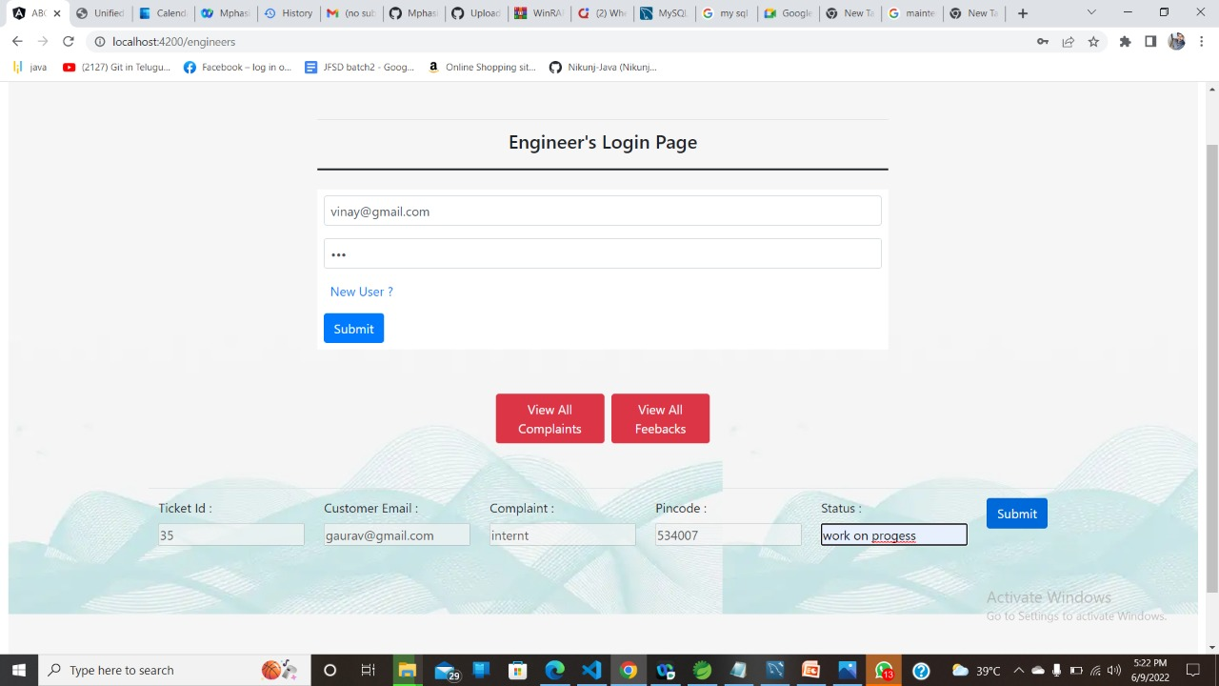
ENGINEERS PAGE

Slide 29
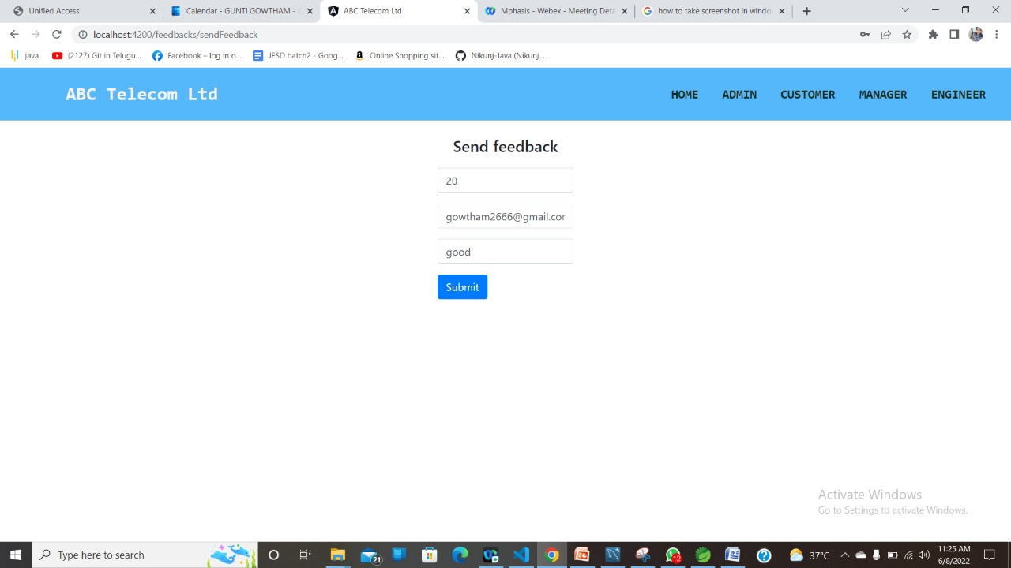
FEEDBACKS PAGE

Slide 30
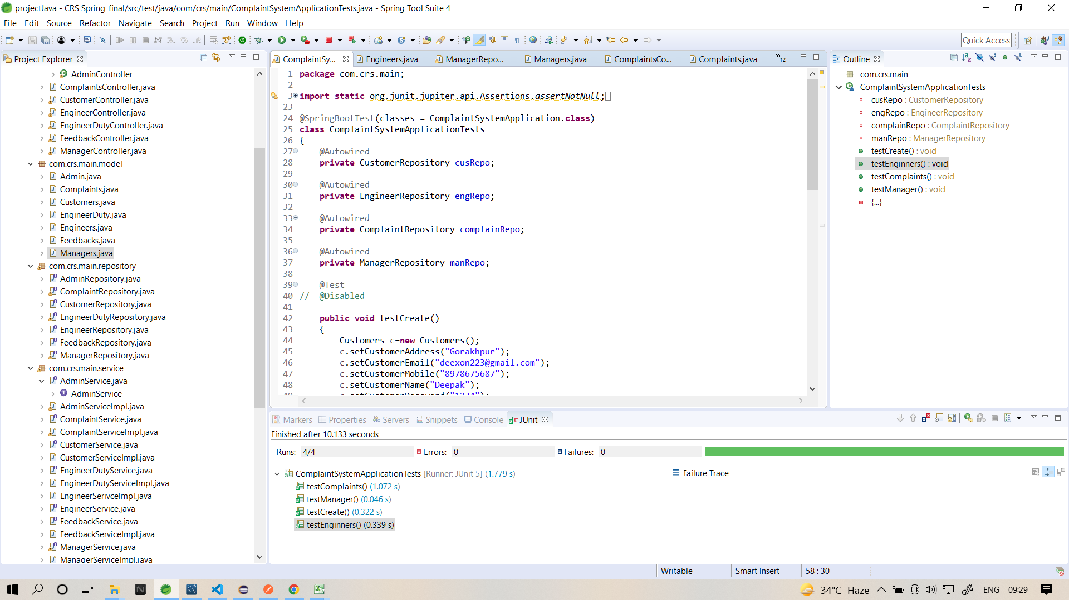
Junit TESTING

Slide 31
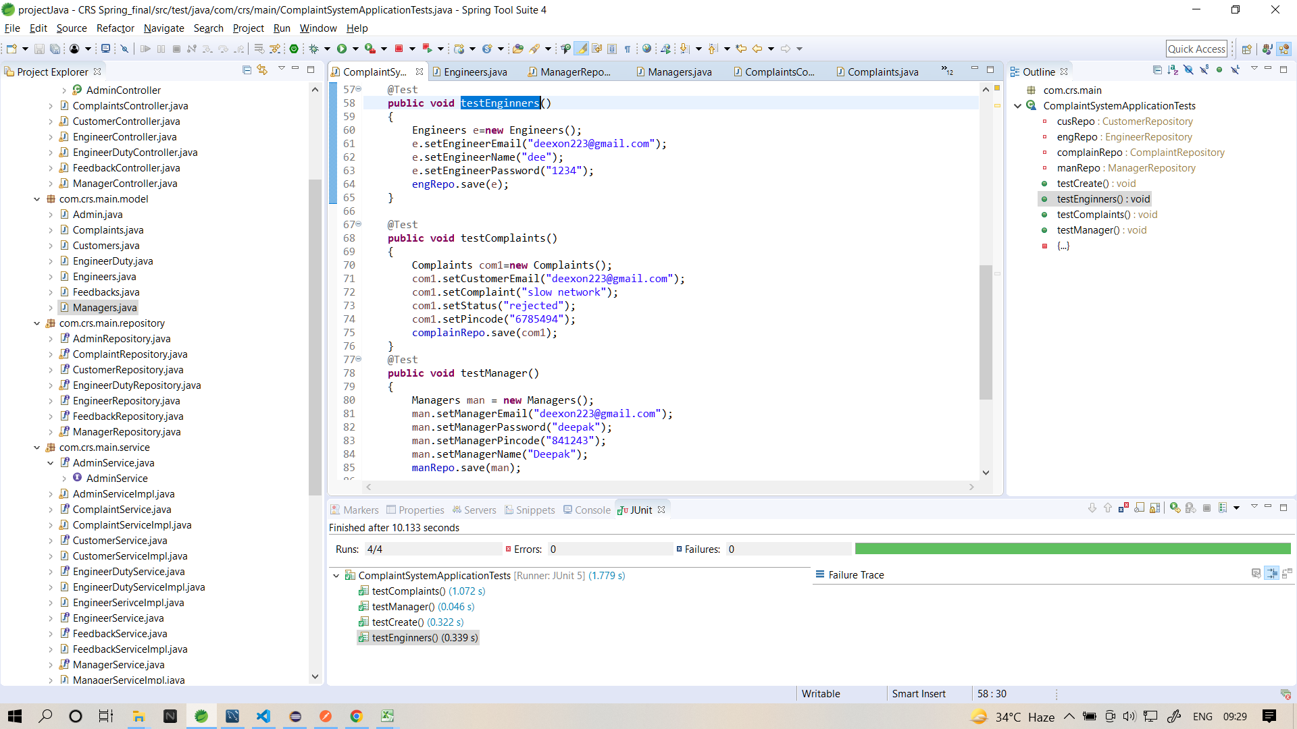
JuNIT TESTING

Slide 32
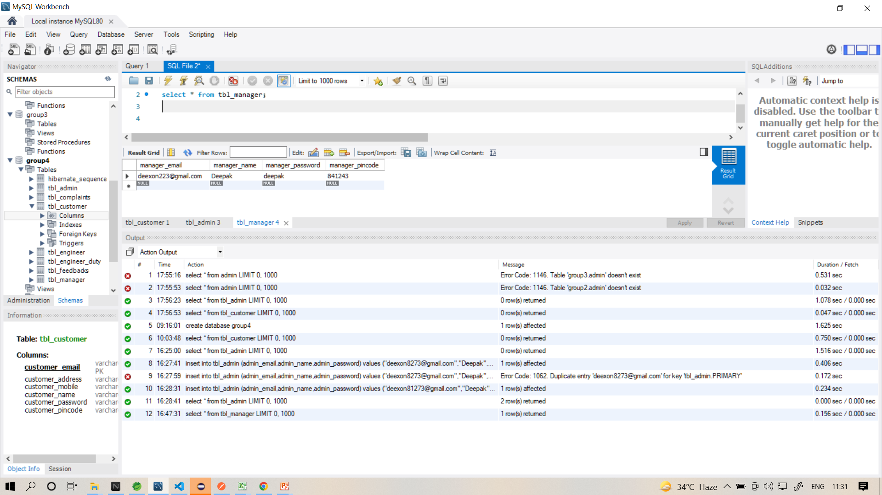

Slide 33
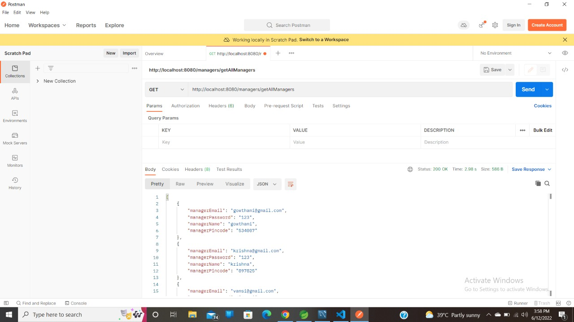
API testing using postman

Slide 34
FUTURE SCOPE
Developed to be used by all the people
Can be used by people of all ages
Makes complaining simple for customers as well as solving for the workers
Time saving
This project can bring a revolution in the complaint redressal system

Slide 35
CONCLUSION
Application software has been computed successfully
and was also tested successfully by passing all the test cases.
It is user friendly and has required options, which can be
utilized by the user to perform desired operations.

Slide 36
THANK YOU

